Slide 1

Do winter cover crops suppress weeds in Midwestern corn- and soybean-based systems? A meta-analysis
Andrea Basche¹, David Weisberger², Virginia Nichols², Alisha Bower³, Chris Wilbeck³, Sarah Carlson³
1. University of Nebraska-Lincoln, Department of Agronomy and Horticulture, Lincoln, NE
2. Iowa State University, Department of Agronomy, Ames, IA
3. Practical Farmers of Iowa, Ames, IA

Slide 2
Project background and rationale
Criteria: Conducted in Midwestern Corn Belt states*, measured weed density or biomass, included a fall planted cover crop before corn or soybean
Focusing on the Corn Belt because of its high production, predominance of annual cropland and opportunity for increased cover crop adoption.
Located 29 potential studies (out of 665 screened) and have included 15 studies in a database for this preliminary analysis
*Illinois, Indiana, Iowa, Kansas, Michigan, Minnesota, Missouri, Nebraska, North Dakota, Ohio, South Dakota, and Wisconsin
Notes:
Midwestern Corn Belt is different than edges of it in SE or MidAtlantic states – we grow corn and beans (will look more at NASS data to see what % of the states are growing c/s).
Fall planted only: window for cc’s that is most likely to advance
We think this is a super important question for our region / environment

Slide 3
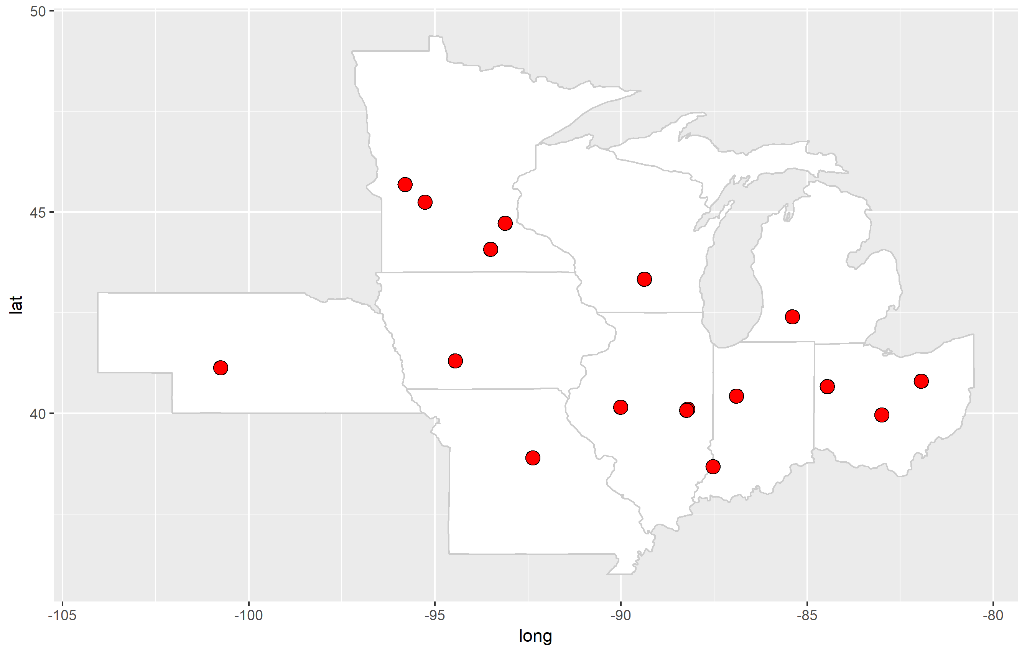

Slide 4
Procedure for building the database
Extract data systematically
Create a ratio of weeds (density or biomass) with a cover crop / weeds without a cover crop
All other treatments are equal
Total of 172 RRs from 15 studies analyzed to date
Different treatments (generally) lead to multiple RRs in each study such as termination method, cover crop species, planting dates, etc.

Slide 5
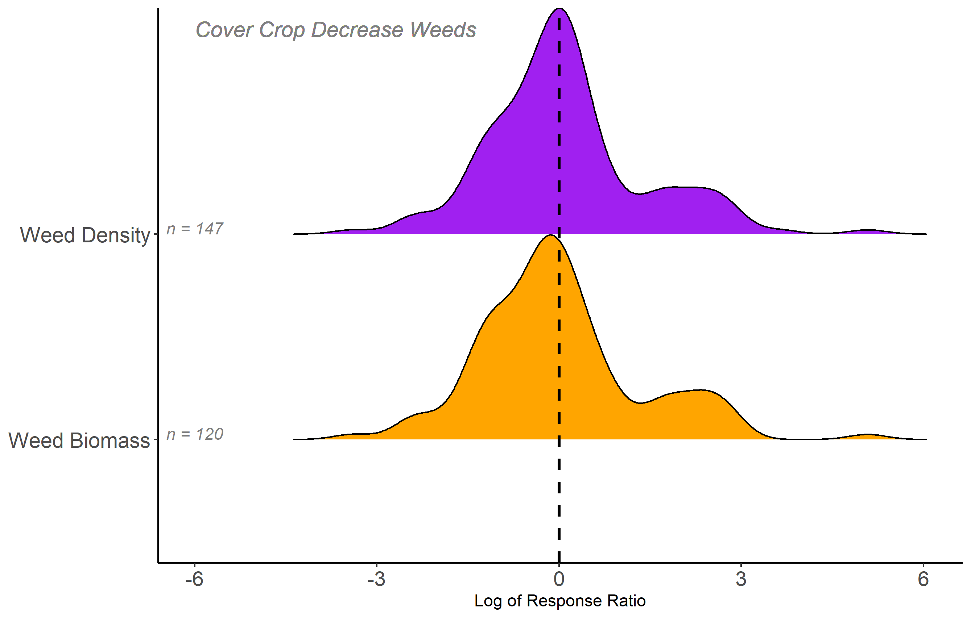
48% of RRs decrease weeds
55% of RRs decrease weeds

Slide 6
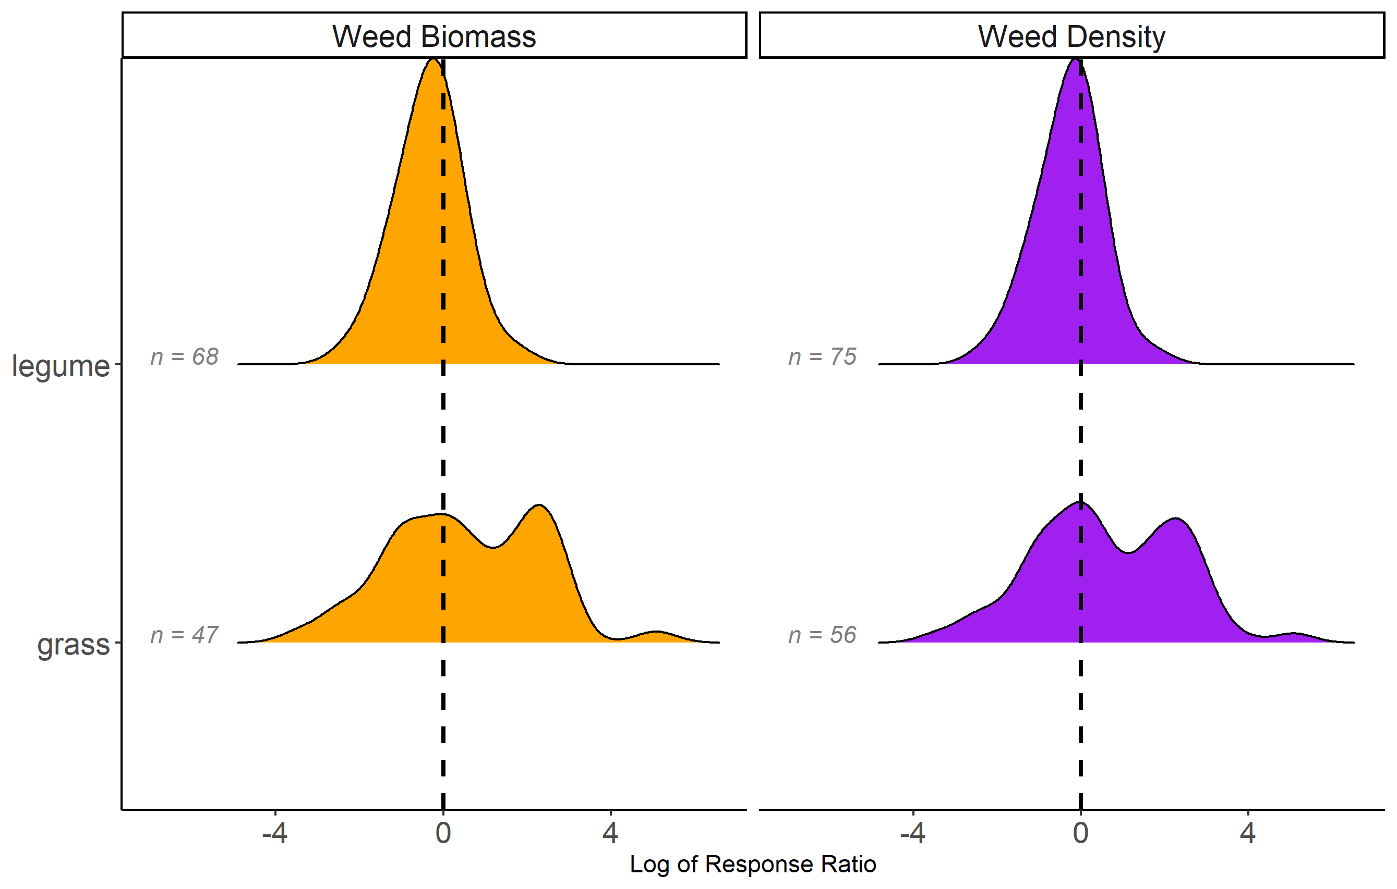

Slide 7
Summary
Research shows that cover crops do not always reduce weeds
Management, especially termination method, seems to be an important factor
Comment on amount of biomass needed
Visit Poster 1137 to learn more from 4-6pm this afternoon!

Slide 8
EXTRA SLIDES FOR NOW
Note that their template is horrible and defaults to the 2017 logo beyond the third slide which is infuriating

Slide 9
State | Year | Cover crop species | Corn or soybean | Authors
OH | 1993 | vetch | corn | Hoffman et al.
MI | 2001 | clover, medic | corn | Fisk et al.
IL | 2002 | vetch | corn | Czapar et al.
OH | 2003 | wheat, vetch | corn, soybean | Gallagher et al.
MN | 2005 | rye | soybean | DeBruin et al.
IL | 2010 | rye, vetch | soybean | Davis et al.
WI | 2011 | rye | soybean | Bernstein et al.
IA | 2012 | mixes | corn, soybean | Delate et al.
MI | 2012 | rye/vetch, vetch | …* | Hayden et al.
IN | 2012 | wheat, ryegrass | corn, soybean | Mock et al.
MN | 2013 | rye | soybean | Forcella et al.
MN | 2016 | radish | corn | Gieske et al.
MO | 2017 | mixes* | soybean | Cornelius and Bradley
IL | 2017 | radish, canola, rye | soybean | Crawford et al.
NE | 2018 | rye | …* | Werle et al.
Notes:
PROBABLY WILL NOT SHOW THIS IN THE PRESENTATION BUT INCLUDING HERE FOR NOW – I PLAN TO INCLUDE THIS IN THE POSTER

Slide 10
